Slide 1
SET THEORY AND VENN DIAGRAM

Slide 2
Super Set , Subset and Power Set
For eg :- A = {1,2,3,4,5} and B = { 2,3,4}

Slide 3
Operations on SETS
For eg :- A = {1,2,3,4,5} and B = { 2,3,4}
Intersection of SETS :- A n B
Union of SETS :- A U B
Complement of SETS :-

Slide 4
Formulas: -
n (A u B) = n (A) + n (B) – n (A n B)
n (A u B u C) = n (A) + n (B) + n (C) – n (A n B) – n (A n C) – n (B n C) + n (A n B n C)

Slide 5
Q1. How many numbers from 1 to 50 are divisible by 3 or 5 or both ?
a. 23 b. 24 c. 26 d. None

Slide 6
Q2. At the birthday party of Sherry, a baby boy, 40 persons chose to hug him and 25 chose to shake hands with him. 10 persons chose to both hug him and shake hands with him. How many persons turned out to party if every person at least shake hands with him or hugs him ?
a. 35 b. 75 c. 55 d. 25

Slide 7
Q3. In the Mindworkzz club all the members participate either in the Tambola or the Fete. 320 participate in the Fete, 350 participate in the Tambola and 220 participate in both. How many members does the club have?
a. 35 b. 75 c. 55 d. 25

Slide 8
Q4. There are 20000 people living in Defence Colony, Guragon. Out of them 9000 subscribe to Star TV Network and 12000 to Zee TV Network. If 4000 subscribe to both, how many do not subscribe to any of the two?
a. 3000 b. 2000 c. 1000 d. 4000

Slide 9
Q5. 30 monkeys went to a picnic. 25 monkeys chose to irritate buffaloes and 20 monkeys chose to irritate cows. How many monkeys chose to irritate both buffaloes and cows ?
a. 10 b. 15 c. 5 d. Cannot be determined

Slide 10
Q6. In a committee, 50 people speak French, 20 speak Spanish and 10 speak both Spanish and French. How many speak at least one of the 2 languages?
a. 50 b. 55 c. 70 d. 60

Slide 11
Q7. In a written test, out of students who appeared, 49% passed in Section A and 35% passed in Section B. Find the percentage of students who appeared but failed in both the sections of the test if 25% of the students passed both sections A and B?
a. 41% b. 38% c. 25% d. Cannot be determined

Slide 12
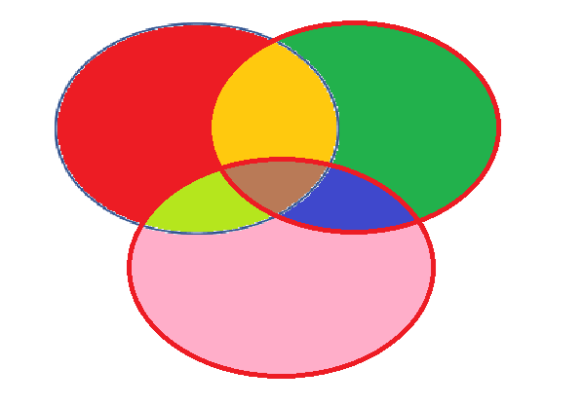

Slide 13
Q8. Among a group of students, 50 played cricket, 50 played hockey and 40 played volleyball. 15 played both cricket and hockey, 20 played both hockey and volleyball, 15 played both cricket and volleyball and 10 played all three. If every student played at least one game, find the number of students who played only cricket?
a. 20 b. 30 c. 50 d. None of these

Slide 14
Q9. In a survey conducted among 120 houses, it was found that 50 read Times of India, 60 read Indian Express and 48 read Hindustan Times, 20 read Times of India and Indian Express, 18 read Times of India and Hindustan Times and 24 read Indian Express and Hindustan Times. If 10 read all three, how many read only one newspaper?
a. 50 b. 32 c. 64 d. 84

Slide 15
Directions (10-13): - Refer to the data below and answer the questions that follow
5% of the passengers who boarded Guwahati-New Delhi Rajdhani Express do not like coffee, tea and ice cream and 10% like all the three. 20% like coffee and tea, 25% like ice cream and coffee and 25% like ice cream and tea. 55% like coffee, 50% like tea and 50% like ice cream.
Q10. The number of passengers who like only coffee is greater than the passengers who like only ice cream by
a. 50% b. 100% c. 25% d. 0

Slide 16
Directions (10-13): - Refer to the data below and answer the questions that follow
5% of the passengers who boarded Guwahati-New Delhi Rajdhani Express do not like coffee, tea and ice cream and 10% like all the three. 20% like coffee and tea, 25% like ice cream and coffee and 25% like ice cream and tea. 55% like coffee, 50% like tea and 50% like ice cream.
Q11. The percentage of passengers who like both tea and ice cream but not coffee is
a. 15 b. 5 c. 10 d. 25

Slide 17
Directions (10-13): - Refer to the data below and answer the questions that follow
5% of the passengers who boarded Guwahati-New Delhi Rajdhani Express do not like coffee, tea and ice cream and 10% like all the three. 20% like coffee and tea, 25% like ice cream and coffee and 25% like ice cream and tea. 55% like coffee, 50% like tea and 50% like ice cream.
Q12. The percentage of passengers who like at least 2 of the products is
a. 40% b. 45% c. 50% d. 60%

Slide 18
Directions (10-13): - Refer to the data below and answer the questions that follow
5% of the passengers who boarded Guwahati-New Delhi Rajdhani Express do not like coffee, tea and ice cream and 10% like all the three. 20% like coffee and tea, 25% like ice cream and coffee and 25% like ice cream and tea. 55% like coffee, 50% like tea and 50% like ice cream.
Q13. If the number of passengers is 180, then the number of passengers who like ice cream only is
a. 10 b. 18 c. 27 d. 36

Slide 19
Directions (14-16): - Refer to the data below and answer the questions that follow
Last year, there were 3 sections in the Catalyst, a mock CAT paper. Out of them 33 students cleared the cut-off in Section 1, 34 students cleared the cut-off in Section 2 and 32 cleared the cut-off in Section 3. 10 students cleared the cut-off in Section 1 and Section 2, 9 cleared the cut-off in Section 2 and Section 3, 8 cleared the cut-off in Section 1 and Section 3. Th number of people who cleared each section alone was equal and was 21 for each section.
Q14. How many cleared all the three sections?
a. 3 b. 6 c. 5 d. 7

Slide 20
Directions (14-16): - Refer to the data below and answer the questions that follow
Last year, there were 3 sections in the Catalyst, a mock CAT paper. Out of them 33 students cleared the cut-off in Section 1, 34 students cleared the cut-off in Section 2 and 32 cleared the cut-off in Section 3. 10 students cleared the cut-off in Section 1 and Section 2, 9 cleared the cut-off in Section 2 and Section 3, 8 cleared the cut-off in Section 1 and Section 3. Th number of people who cleared each section alone was equal and was 21 for each section.
Q15. How many cleared only 1 out of the 3 sections?
a. 21 b. 63 c. 42 d. 52

Slide 21
Directions (14-16): - Refer to the data below and answer the questions that follow
Last year, there were 3 sections in the Catalyst, a mock CAT paper. Out of them 33 students cleared the cut-off in Section 1, 34 students cleared the cut-off in Section 2 and 32 cleared the cut-off in Section 3. 10 students cleared the cut-off in Section 1 and Section 2, 9 cleared the cut-off in Section 2 and Section 3, 8 cleared the cut-off in Section 1 and Section 3. Th number of people who cleared each section alone was equal and was 21 for each section.
Q16. The ratio of the number of students clearing the cut-off in one or more of the sections to the number of students clearing the cut-off in Section 1 alone is?
a. 78:21 b. 3:1 c. 73:21 d. None of these

Slide 22
THANK YOU

